Slide 1
Sixth Sense
Weekly Report
2019. 10. 2
32172980 이민석
32131697 나명수
32153550 이제연
32144107 전세호

Slide 2
Basics of Yolo
Source analysis
Consideration

Slide 3
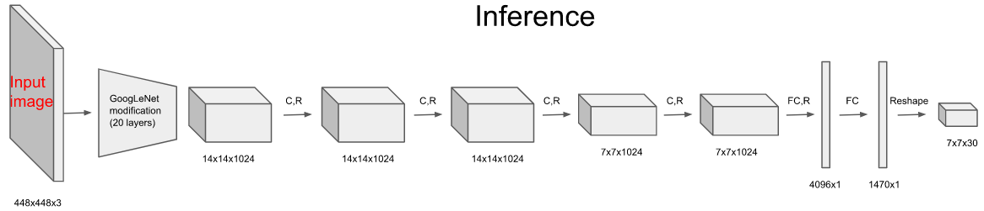
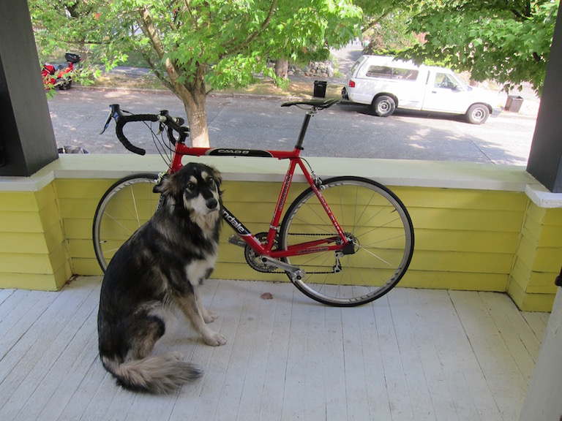
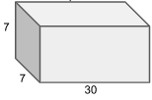
1. Basics of Yolo
Yolo
convolution layers
0
9
29
20
bounding box properties
Score of attribute
Property of existence of object
X
0
bounding box

Slide 4
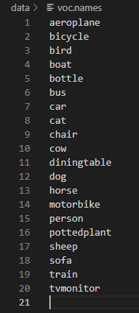
1. Basics of Yolo
Yolo
Class aeroplane
.....
bounding box
Dog

Slide 5
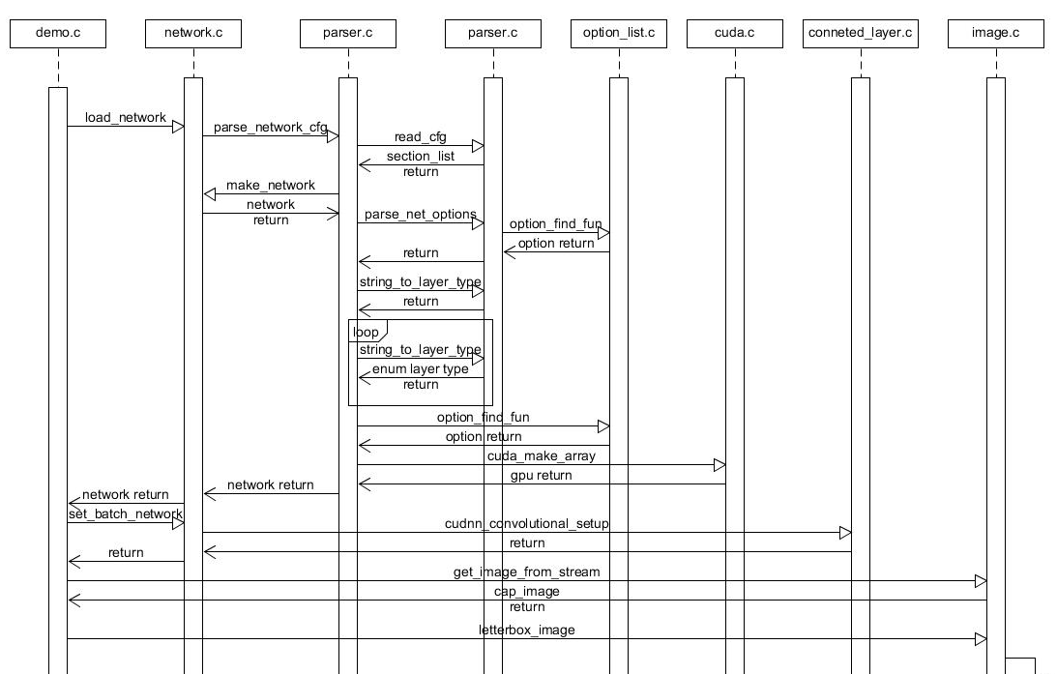
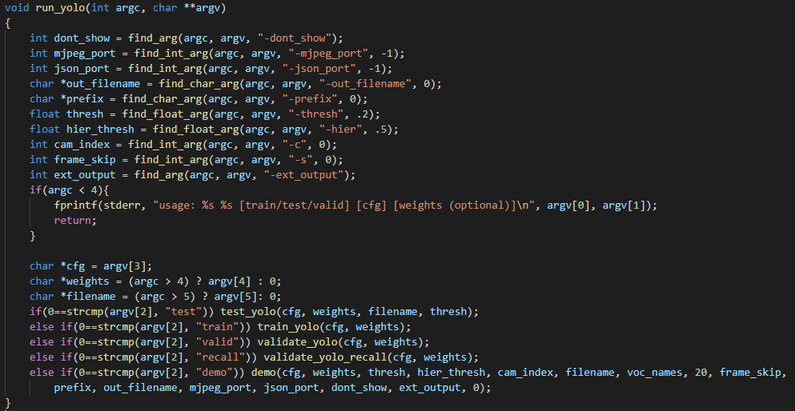
2. Source analysis
Yolo /src/yolo.c::run_yolo

Slide 6

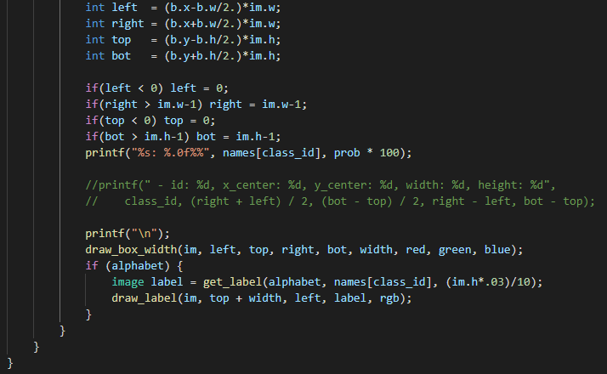
2. Source analysis
Yolo

Slide 7
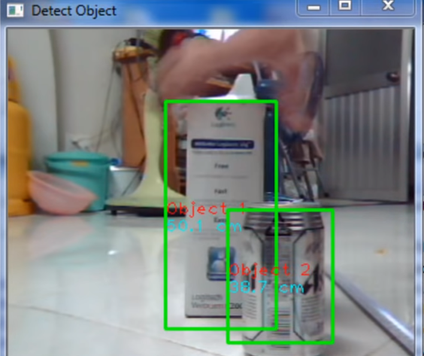
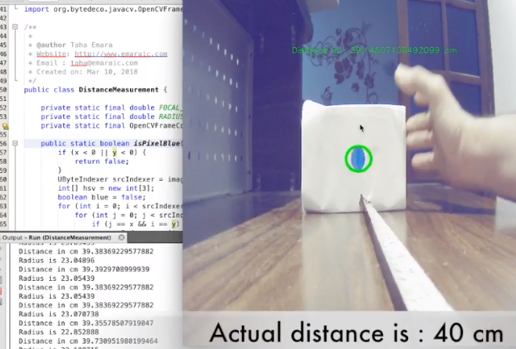
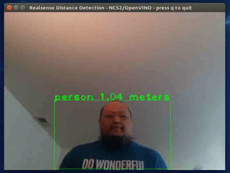
3. Consideration
Distance measuring

